Slide 1



ExTensor: An Accelerator for Sparse Tensor Algebra
Kartik Hegde¹, Hadi Asghari-Moghaddam¹, Michael Pellauer², Neal Crago², Aamer Jaleel², Edgar Solomonik¹, Joel Emer^{2,3}, Christopher W. Fletcher¹
¹UIUC
²NVIDIA
³MIT

Slide 2
Tensor Algebra
Overview
Hierarchical Intersection
Hardware Intersection
Architecture
Evaluation
9
1
0
-5
3
2
Tensor is a multidimensional array
  0D: Scalar
  1D: Vector
  2D: Matrix
  3D or higher: …
Tensor algebra kernels are series of binary operations between tensors
  E.g., Matrix multiplication
0D Tensor/ Scalar
1D Tensor/ vector
2
0
0
2
0
0
2
0
0
2
0
0
1
8
-4
1
8
-4
1
8
-4
1
8
-4
-5
0
-1
-5
0
-1
-5
0
-1
-5
0
-1
2D Tensor/ Matrix
3D Tensor/ Cube
4D Tensor
5D Tensor

Slide 3


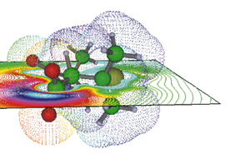
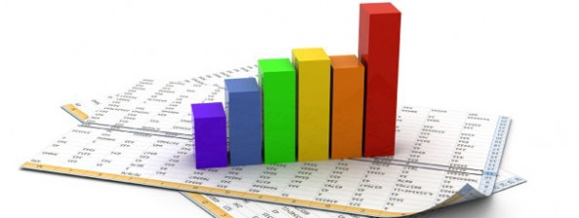


Overview
Hierarchical Intersection
Hardware Intersection
Architecture
Evaluation
Challenges and Opportunities
Matrix multiplication is not the only kernel
Problem domains are in [dense … hyper-sparse]
Inner Product
Challenges
GEMV
MTTKRP
TTM
Efficient handling regardless of the density
GEMM
Convolution
Efficient processing of all tensor algebra kernels
Opportunities
TTV
SDDMM
Internet &
Social media
Recommendation systems
Circuit Simulation
Computational Chemistry
Problems in Statistics
Deep Learning
Density:
(log scale)
>10⁻⁶%
10⁻⁴%
10⁻²%
1%
100%

Slide 4
Overview
Hierarchical Intersection
Hardware Intersection
Architecture
Evaluation
ExTensor Contributions
ExTensor: The first accelerator for sparse tensor algebra
Key Idea: Hierarchical Intersection
→ Removing operations by exploiting sparsity
Novel intersection algorithm and hardware design

Slide 5
Intersection Opportunities

Slide 6
Key Idea
Overview
Hierarchical Intersection
Hardware Implementation
Architecture
Evaluation
Basic Opportunity: x * 0 = 0 for all x
  Skipping ineffectual operations
Case 1: x is a scalar
Case 2: x is a tile/tensor
Case 3: x is an un-evaluated tensor
=
x
*
0
0
Matrix A
X is a tile
X is a scalar
X is a tensor

Slide 7

Overview
Hierarchical Intersection
Hardware Implementation
Architecture
Evaluation
Opportunities from Exploiting Sparsity
1. Scalar Intersection
Example: Inner product (A B)
Savings
Coordinates
Coordinate
Reduce storage
Eliminate compute
+
Eliminate data fetches
Opportunities exploited by other sparse accelerators (e.g., EIE, SCNN)
2
2
ExTensor

Slide 8
Overview
Hierarchical Intersection
Hardware Implementation
Architecture
Evaluation
Opportunities from Exploiting Sparsity
2. Tile/Tensor Intersection
Example: Sparse Matrix Multiply (A x B)
Savings
Row Coordinate
Reduce storage
Eliminate compute
A
+
Eliminate data fetches
Column Coordinate
+
Eliminate metadata fetches
B

Slide 9
Overview
Hierarchical Intersection
Hardware Implementation
Architecture
Evaluation
Opportunities from Exploiting Sparsity
3. Unevaluated Tenser
Example: Sampled Dense Matrix Multiply (A (C x D))
Savings
Reduce storage
Eliminate compute
+
Eliminate data fetches
+
Eliminate metadata fetches
Suppose B = C x D
+
Eliminate sub-tensor kernels

Slide 10
Takeaway
Opportunities are all intersections between sets of coordinates
Coordinate
0
2

Slide 11
Hardware for Optimized Intersection

Slide 12
Scanner:
Producing Coordinate Stream
A
0
2
0
Coordinate
Scanner
0
2
2
0

Slide 13
Intersection Unit:
Intersect Coordinate Streams
Overview
Hierarchical Intersection
Hardware Intersection
Architecture
Evaluation
Scanners produce streams of coordinates
Intersect unit finds matching coordinates
A
Control
Coordinates:
1
5
6
7
8
8
9
7
5
B
Scanner
A
6
4
Scanner
B
5
3
Coordinates:
2
3
4
5
9
1
2
Current intersection time:
  9 cycles
Theoretical lower-bound time:
  1 common coordinate -> 1 cycle
Intersect
5

Slide 14
Skip-Based Intersection:
Optimized Design
Overview
Hierarchical Intersection
Hardware Intersection
Architecture
Evaluation
Observation:
  Consecutive coordinates can be interpreted as a range of ineffectual coordinates in other stream
Control
A
1
5
6
7
8
8
9
Coordinates:
Scanner
A
7
5
Scanner
B
2
3
4
5
9
6
4
5
3
B
1
2
Solution:
  Iterate both A and B.
  Propagate Skip(begin, end) signals all-to-all
  Skip() jumps stream ahead in its iteration
Intersect
(1,5)
(5,9)
5

Slide 15
Extensor: Accelerator based on
Hierarchical Intersection

Slide 16
ExTensor Architecture
Overview
Hierarchical Intersection
Hardware Intersection
Architecture
Evaluation
Efficient Intersection at:
Savings from Intersection:
Two levels of buffering
  Last Level Buffer (LLB)
  PE buffer
Scanners
  Dataflow
  Tensor kernel
  Representation
DRAM
DRAM -> LLB
Skip loading L1 tile data+metadata
Scanners
Last Level Buffer (LLB)
LLB
(L2)
Scanners
LLB -> PE
Skip loading L1 tile data
PEs:
PE buffer
datapath
Scanner
PE Array
PE Buffers (L1)
+
x
PE level
Skip compute
&
|
buffer

Slide 17
Evaluation

Slide 18
Methodology
Overview
Hierarchical Intersection
Hardware Intersection
Architecture
Evaluation
Evaluations are based on Cycle-accurate Simulation
Datasets:
  FROSTT Tensors
  Florida Sparse Matrices
Kernels Evaluated:
  SpMSpM
  TTV/TTM
  SDDMM
Parameter | ExTensor | CPU (Xeon E5-2687W v4)
Num Cores | 128 PEs | 12C/24T
Frequency | 1 GHz | 3 GHz (3.5GHz Turbo)
DRAM Bandwidth | 68.256 GB/s | 68.256 GB/s
On-chip Buffer | 30MB | 30MB
Experimental Setup:
iso memory/DRAM-bandwidth

Slide 19
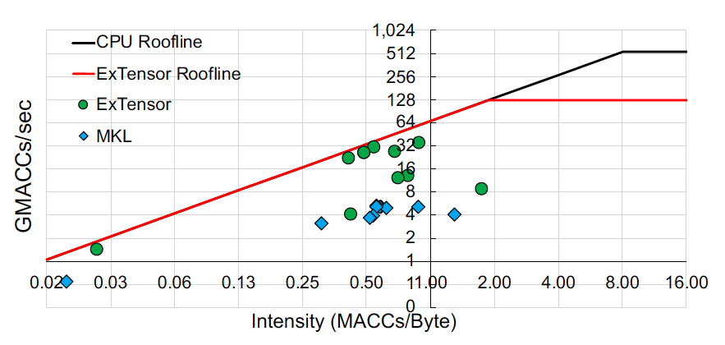
Performance For SpMSpM
Overview
Hierarchical Intersection
Hardware Intersection
Architecture
Evaluation
Sparse matrixes x sparse matrix (SpMSpM)
  3.4x ↑ (up-to 6.2x ↑) faster than CPU (Intel MKL)
  3.1x ↑ higher bandwidth utilization
  Skip-based intersection unit is 3x ↑ faster than no-skip
Performance Relative to CPU
3.4x ↑
Roofline Analysis
Roofline Analysis

Slide 20
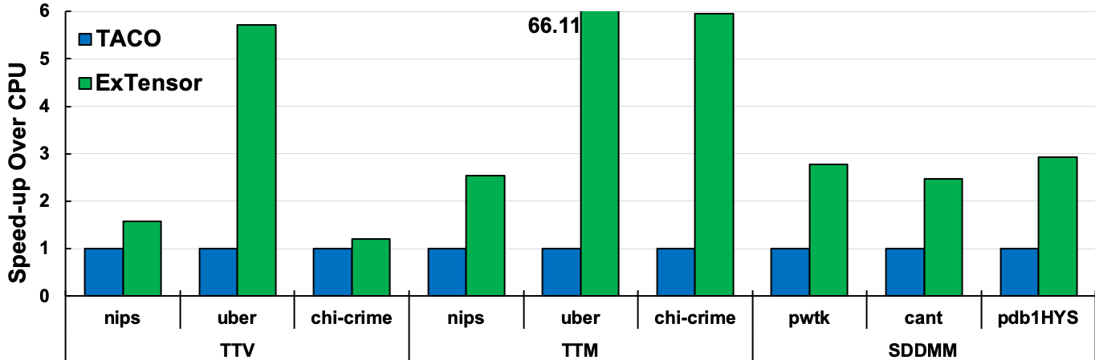
Performance For Higher-Order Tensors
Overview
Hierarchical Intersection
Hardware Intersection
Architecture
Evaluation
TTV (3D-Tensor Times Vector)
TTM (3D-Tensor Times Matrix)
SDDMM (Sampled dense-dense matrix multiplication)
2.8x ↑
24.9x ↑
2.7x ↑
2.8x ↑
24.9x ↑
2.7x ↑

Slide 21
Conclusion
Overview
Hierarchical Intersection
Hardware Intersection
Architecture
Evaluation
Sparse Tensor Algebra is growing in importance across domains
  Variety of kernels featuring a range of sparsity
ExTensor is:
  A programmable accelerator for Sparse Tensor Algebra
  Based on hierarchical intersection to eliminate ineffectual work
Demonstrated significant speed-up over state-of-the-art approaches
  SpMSpM: 3.4x ↑ over CPU

Slide 22

Questions

Slide 23
Backup Slides

